Slide 1
NodeJS Fundamental (session 3)
Tran Minh

Slide 2
Agenda
Node.js basic concept
Working with Database in Node
How to Build and Structure a Node.js MVC Application
Local Authentication Using Passport in Node.js
How to Debug a Node App
Q&A

Slide 3
Node.js Basic Concept
Focus Items
Node.js Modules
Node.js HTTP Module
Node.js File System
Node.js URL Module
Node.js Events
Node.js Upload Files
Node.js Email

Slide 4
Node.js Modules
Node.js Module is a set of functions.
Built-in Modules
Node.js has a set of built-in modules which you can use without any further installation
Assert, buffer, child_process, cluster, crypto, dgram, dns, domain, events, etc.
Include Modules
To include a module, use the require() function with the name of the module
const http = require('http'); http.createServer(function (req, res) { res.writeHead(200, {'Content-Type': 'text/html'}); res.end('Hello World!'); }).listen(8080);

Slide 5
Node.js Modules (2)
Create your own module: (my_module.js)
Create test_my_module.js to include own module
Notice that we use ./ to locate the module, that means that the module is in the same folder as the Node.js file
exports.myDateTime = () => { return Date(); }
const http = require('http'); const myDT = require('./my_module'); http.createServer(function (req, res) { res.writeHead(200, {'Content-Type': 'text/html'}); res.end(`Current Date Time: ${myDT.myDateTime()}`); }).listen(3000);

Slide 6
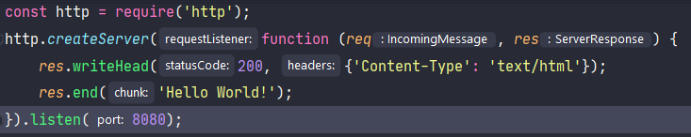
Node.js HTTP Module
Node.js has a built-in module called HTTP, which allows Node.js to transfer data over the Hyper Text Transfer Protocol (HTTP)
Node.js as a Web Server
http.createServer() will be executed when user access website via port 8080
res.writeHead() allow us add HTTP Header

Slide 7
Node.js HTTP Module (2)
Node.js has a built-in module called HTTP, which allows Node.js to transfer data over the Hyper Text Transfer Protocol (HTTP)
Node.js as a Web Server
http.createServer() will be executed when user access website via port 8080
res.writeHead() allow us add HTTP Header

Slide 8
Node.js HTTP Module (3)
req.url will return link of request
There are built-in modules to easily split the query string into readable parts, such as the URL module.
const http = require('http'); http.createServer(function (req, res) { res.writeHead(200, {'Content-Type': 'text/html'}); // Return link of request. example http://localhost:8080/test --> req.url --> /test res.write(req.url); res.end('Hello World!'); }).listen(8080);
const http = require('http'); const url = require('url'); http.createServer(function (req, res) { res.writeHead(200, {'Content-Type': 'text/html'}); const q = url.parse(req.url, true).query; // Query string will have year and month const txt = `Query String with Year: ${q.year} - Month: ${q.month}`; res.end(txt); }).listen(8080);

Slide 9
Node.js File System
The Node.js file system module allows you to work with the file system on your computer.
Common use for the File System Module
Read files
Create files
Update files
Delete files
Rename files
const fs = require('fs');

Slide 10
> Read files
fs.readFile() method is used to read files on your computer
We will write some code for demo.
Assume we have following HTML file (located in the same folder):
<!DOCTYPE html> <html lang="en"> <head> <meta charset="UTF-8"> <title>Demo Read File</title> </head> <body> <h1>Demo Read File</h1> <p> This is the first Paragraph </p> </body> </html>

Slide 11
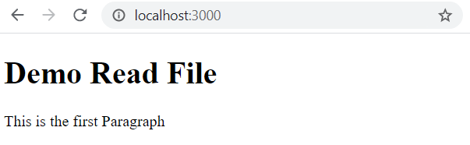
> Read files (2)
Create demo_read_file.js
Run command line: node demo_read_file.js
const http = require('http'); const fs = require('fs'); http.createServer((req, res) => { fs.readFile('demo_file_1.html', (err, data) => { res.writeHead(200, {'Content-Type': 'text/html'}); res.write(data); res.end(); }); }).listen(3000);

Slide 12
> Create Files
The File System module has methods for creating new files:
fs.appendFile()
fs.open()
fs.writeFile()
fs.appendFile() method appends specified content to a file. If the file does not exist, the file will be created.
Create append_file.js
const fs = require('fs'); fs.appendFile('myfile.txt', 'New content', (err) => { if (err) throw err; console.log('Saved!'); });

Slide 13
> Create Files (2)
fs.open() method take a “flag” as second argument
If the flag is “w” for “writing”, the specified file is opened for writing
If the file does not exist, an empty file is created
Create open_file_writing.js
const fs = require('fs'); fs.open('myfile2.txt', 'w', (err) => { if (err) throw err; console.log('Saved'); });

Slide 14
> Create Files (3)
fs.writeFile() method replaces the specified file and content if it exists. If the file does not exist, a new file containing the specified content will be created.
Create write_file.js
const fs = require('fs'); fs.writeFile('myfile3.txt', 'Hello content', (err) => { if (err) throw err; console.log('Saved'); });

Slide 15
> Update Files
The File System module has methods for updating files
fs.appendFile(): appends the specified content at the end of specified file
fs.writeFile(): replaces the specified file and content
Create update_file_with_append.js
Create update_file_with_writeFile.js
const fs = require('fs'); fs.appendFile('myfile.txt', ' This is updated content', (err) => { if (err) throw err; console.log('Updated!'); });
const fs = require('fs'); fs.writeFile('myfile3.txt', 'This is new content', (err) => { if (err) throw err; console.log('Replaced'); });

Slide 16
> Delete Files
To delete a file with File System module, use fs.unlink()
Create delete_file.js
const fs = require('fs'); fs.unlink('myfile2.txt', (err) => { if (err) throw err; console.log('File Deleted'); });

Slide 17
> Rename Files
To rename a file with File System module, use fs.rename()
Create rename_file.js
const fs = require('fs'); fs.rename('myfile.txt', 'myfile1.txt', (err) => { if (err) throw err; console.log('File Renamed!'); });

Slide 18
Node.js URL Module
The URL module splits up a web address into readable parts.
Split a web address into readable parts:
We will build File Server based on URL Module.
const url = require('url'); const currentDate = new Date(); const adr = `http://localhost:8080/default.htm?year=${currentDate.getFullYear()}&month=${currentDate.getMonth() + 1}`; const q = url.parse(adr, true); console.log(q.host); //returns 'localhost:8080' console.log(q.pathname); //returns '/default.htm' console.log(q.search); //returns '?year=2020&month=5' const qdata = q.query; //returns an object: { year: 2020, month: 5} console.log(qdata.month); //returns 5

Slide 19
Node.js URL Module (2)
Assume we have two html files: winter.html and summer.html
<!DOCTYPE html> <html lang="en"> <head> <meta charset="UTF-8"> <title>URL Module - Demo File Server</title> </head> <body> <h1>Summer</h1> <p>I love the sun!</p> </body> </html>
<!DOCTYPE html> <html lang="en"> <head> <meta charset="UTF-8"> <title>URL Module - Demo File Server</title> </head> <body> <h1>Winter</h1> <p>I love the snow!</p> </body> </html>

Slide 20
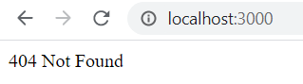
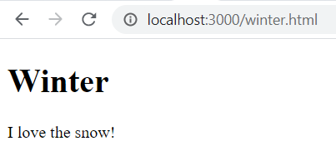
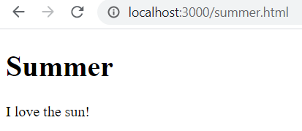
Node.js URL Module (3)
Create demo_fileserver.js
const http = require('http'); const url = require('url'); const fs = require('fs'); http.createServer((req, res) => { const q = url.parse(req.url, true); const filename = "." + q.pathname; fs.readFile(filename, (err, data) => { if (err) { res.writeHead(404, {'Content-Type': 'text/html'}); return res.end("404 Not Found"); } res.writeHead(200, {'Content-Type': 'text/html'}); res.write(data); res.end(); }); }).listen(3000);

Slide 21
Node.js Events
Node.js is perfect for event-driven applications.
Every action on a computer is an event. Like when a connection is made, or a file is opened.
Objects in Node.js can fire events, like the readStream object fires events when opening and closing a file
const fs = require('fs'); const rs = fs.createReadStream('./demofile.txt'); rs.on('open', () => { console.log('The file is open'); });

Slide 22
Node.js Events (2)
Node.js has a built-in module, called "Events", where you can create-, fire-, and listen for- your own events.
All event properties and methods are an instance of an EventEmitter object.
Create demo_eventemitter.js
const events = require('events'); const eventEmitter = new events.EventEmitter(); // Create an event handler const myEventHandler = () => { console.log('I hear a scream'); } // Assign the event handler to an event eventEmitter.on('scream', myEventHandler); // Fire the 'scream' event eventEmitter.emit('scream');

Slide 23
Node.js Upload Files
Formidable Module: npm install formidable
const formidable = require(‘formidable’)
Step 1: Create an Upload Form (upload_file.js)
const http = require('http'); http.createServer(function (req, res) { res.writeHead(200, {'Content-Type': 'text/html'}); res.write('<form action="fileupload" method="post" enctype="multipart/form-data">'); res.write('<input type="file" name="filetoupload"><br>'); res.write('<input type="submit">'); res.write('</form>'); return res.end(); }).listen(8080);

Slide 24
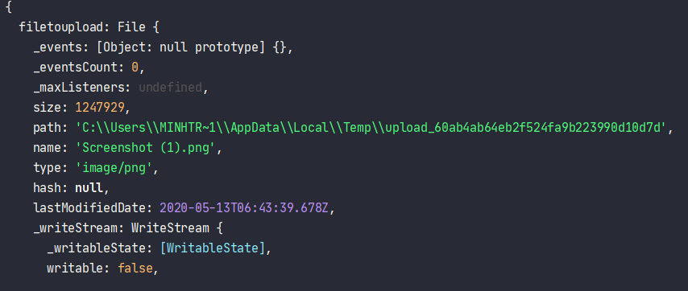
Node.js Upload Files (2)
Step 2: Parse the Uploaded File.
Update upload_file.js
const http = require('http'); const formidable = require('formidable'); http.createServer(function (req, res) { if (req.url === '/fileupload') { const form = new formidable.IncomingForm(); form.parse(req, (err, fields, files) => { console.log(files); res.write('File uploaded'); res.end(); }) } else { res.writeHead(200, {'Content-Type': 'text/html'}); res.write('<form action="fileupload" method="post" enctype="multipart/form-data">'); res.write('<input type="file" name="filetoupload"><br>'); res.write('<input type="submit">'); res.write('</form>'); return res.end(); } }).listen(8080);

Slide 25
Node.js Upload Files (3)
Step 3: Save the File. (Must same your tmp directory)
Update upload_file.js
const http = require('http'); const formidable = require('formidable'); const fs = require('fs'); http.createServer(function (req, res) { if (req.url === '/fileupload') { const form = new formidable.IncomingForm(); form.parse(req, (err, fields, files) => { const oldPath = files.filetoupload.path; const newPath = `C:/Users/Your Name/${files.filetoupload.name}`; fs.rename(oldPath, newPath, (err) => { if (err) throw err; res.write('File uploaded and moved'); res.end(); }); }) } else { res.writeHead(200, {'Content-Type': 'text/html'}); res.write('<form action="fileupload" method="post" enctype="multipart/form-data">'); res.write('<input type="file" name="filetoupload"><br>'); res.write('<input type="submit">'); res.write('</form>'); return res.end(); } }).listen(8080);

Slide 26
Node.js Email
We can use nodemailer to send email from your computer
npm install nodemailer
const nodemailer = require('nodemailer'); const transporter = nodemailer.createTransport({ service: 'gmail', auth: { user: 'youremail@gmail.com', pass: 'yourpassword' } }); const mailOptions = { from: 'youremail@gmail.com', to: 'myfriend@yahoo.com', subject: 'Test gui mail tu Node.js', text: 'Nhan duoc chua ne' }; transporter.sendMail(mailOptions, (err, info) => { if (err) { console.log(err); } else { console.log(`Email sent: ${info.response}`); } });

Slide 27
Working with Database in Node
Focus Items
Working with MySQL
Working with MongoDB

Slide 28
Working with MySQL
To access a MySQL database with Node.js, you need a MySQL driver.
We will use the “mysql” module
We will test some common functionality of “mysql”
Connect DB
Create database
Create table
Insert/ Select/ Delete data

Slide 29
Connect to DB
Create connect_db.js
const mysql = require('mysql'); const con = mysql.createConnection({ host: "localhost", user: "sa", password: "" }); con.connect(function(err) { if (err) throw err; console.log("Connected!"); });

Slide 30
Create database
Create create_database.js
const mysql = require('mysql'); const con = mysql.createConnection({ host: "localhost", user: "sa", password: "" }); con.connect(function(err) { if (err) throw err; console.log("Connected!"); con.query("CREATE DATABASE mydb", (err, result) => { if (err) throw err; console.log("Database created"); }); });

Slide 31
Create table
Create create_table.js
const mysql = require('mysql'); const con = mysql.createConnection({ host: "localhost", user: "sa", password: "", database: "mydb" // database that we will use }); con.connect(function(err) { if (err) throw err; console.log("Connected!"); const sql = "CREATE TABLE customers (name VARCHAR(255), address VARCHAR(255))"; con.query(sql, (err, result) => { if (err) throw err; console.log("Table created"); }); });

Slide 32
Insert into
Create insert.js
const mysql = require('mysql'); const con = mysql.createConnection({ host: "localhost", user: "sa", password: "", database: "mydb" }); con.connect(function(err) { if (err) throw err; console.log("Connected!"); const sql = "INSERT INTO customers (name, address) VALUES ('NashTech Company', '364 Cong Hoa')"; con.query(sql, (err, result) => { if (err) throw err; console.log("1 record inserted"); }); });

Slide 33
Select data from table
Create select.js
const mysql = require('mysql'); const con = mysql.createConnection({ host: "localhost", user: "sa", password: "", database: "mydb" }); con.connect(function(err) { if (err) throw err; console.log("Connected!"); const sql = "SELECT * FROM customers"; con.query(sql, (err, result, fields) => { if (err) throw err; console.log(result, fields); }); });

Slide 34
Query forms
In “mysql” module, .query have some forms:
Simplest: .query(sqlString, callback)
Place holder values: .query(sqlString, values, callback)
con.query('SELECT * FROM `books` WHERE `author` = "David"', function (error, results, fields) { // error will be an Error if one occurred during the query // results will contain the results of the query // fields will contain information about the returned results fields (if any) });
con.query('SELECT * FROM `books` WHERE `author` = ?', ['David'], function (error, results, fields) { // error will be an Error if one occurred during the query // results will contain the results of the query // fields will contain information about the returned results fields (if any) });

Slide 35
Query forms (2)
The third form .query(options, callback) comes when using various advanced options on the query: escaping query values, joins with overlapping column names, timeouts, and type casting.
con.query({ sql: 'SELECT * FROM `books` WHERE `author` = ?', timeout: 40000, // 40s values: ['David'] }, function (error, results, fields) { // error will be an Error if one occurred during the query // results will contain the results of the query // fields will contain information about the returned results fields (if any) });

Slide 36
Query forms (3)
Combination of the second and third forms
Can be used where the placeholder values are passed as an argument and not in the options object
The values argument will override the values in the option object.
con.query({ sql: 'SELECT * FROM `books` WHERE `author` = ?', timeout: 40000, // 40s }, ['David'], function (error, results, fields) { // error will be an Error if one occurred during the query // results will contain the results of the query // fields will contain information about the returned results fields (if any) } );

Slide 37
Transaction
MySQL support transaction
con.beginTransaction(function(err) { if (err) { throw err; } const title = 'The first title'; con.query('INSERT INTO posts SET title=?', title, function (error, results, fields) { if (error) { return con.rollback(function() { throw error; }); } const log = 'Post ' + results.insertId + ' added'; con.query('INSERT INTO log SET data=?', log, function (error, results, fields) { if (error) { return con.rollback(function() { throw error; }); } con.commit(function(err) { if (err) { return con.rollback(function() { throw err; }); } console.log('success!'); }); }); }); });

Slide 38
Working with MongoDB
We will use the “mongodb” module
npm install mongodb
We create mongodb/index.js to work with mongo
const mongo = require('mongodb'); // To create DB, we need MongoClient object const mongoClient = mongo.MongoClient; const url = "mongodb://localhost:27017/" const dbName = 'mydb'; mongoClient.connect(url, { useUnifiedTopology: true }, (err, client) => { if (err) throw err; console.log("Connect to Database!"); const db = client.db(dbName); client.close(); });

Slide 39
Insert a Document
We can use insertMany function to insert document.
Update index.js to call insertDocument()
const insertDocument = (db, collectionName, data, callback) => { // Get document of collection const collection = db.collection(collectionName); collection.insertMany(data, (err, result) => { if (err) throw err; console.log(`Inserted ${result.ops.length} documents into the collection`); callback(result); }); }
const db = client.db(dbName); const data = [ {name: 'NashTech', addr:'364 Cong Hoa'}, {name: 'KMS', addr:'123 Cong Hoa'} ] insertDocument(db, 'customers', data, () => { client.close(); })

Slide 40
Find All Documents
We will use collection.find
Update index.js to call insertDocument()
const findAllDocuments = (db, collectionName, callback) => { // Get document of collection const collection = db.collection(collectionName); collection.find({}).toArray((err, docs) => { if (err) throw err; console.log('Found the following records'); console.log(docs); callback(docs); }); }
insertDocument(db, 'customers', data, () => { findAllDocuments(db, 'customers', () => { client.close(); }); })

Slide 41
Find with condition and Async - Await
Create find_document_async.js
findOne() method to find document
Connect db and call findOne() with query
const findOne = async (db, collectionName, query) => { try { // Get document of collection const collection = db.collection(collectionName); return await collection.findOne(query); } catch (err) { throw err } }
mongoClient.connect(url, { useUnifiedTopology: true }, async (err, client) => { if (err) throw err; console.log("Connect to Database!"); const db = client.db(dbName); const query = { name: 'NashTech' }; const result = await findOne(db, 'customers', query); console.log('Ket qua: ', result); await client.close(); });

Slide 42
Build and Structure a Node.js MVC Application
Focus Items
What is MVC?
Laying out the Foundation
Storing our settings
Defining the Routes
Building the Models
Building the Controllers
Building the Views

Slide 43
What is MVC?
Model-View-Controller (or MVC) is probably one of the most popular architectures for applications
Model: the part of our application that will deal with the database or any data-related functionality.
View: everything the user will see. Basically, the pages that we’re going to send to the client.
Controller: the logic of our site, and the glue between models and views. Here we call our models to get the data, then we put that data on our views to be sent to the users.
We will build an application that allow us to create, view, edit and delete plain-text notes.

Slide 44
Laying out the Foundation
Create folder notes-board, run npm init to create package.json
We will install Hapi.js framework for this tutorial: npm i @hapi/hapi
Create server.js to start web server
"use strict"; const Hapi = require("@hapi/hapi"); const Settings = require("./settings"); const init = async () => { const server = new Hapi.Server({ port: Settings.port }); server.route({ method: "GET", path: "/", handler: (request, h) => { return "Hello, world!"; } }); await server.start(); console.log(`Server running at: ${server.info.uri}`); }; process.on("unhandledRejection", err => { console.log(err); process.exit(1); }); init();

Slide 45
Storing our settings
It’s good practice to store our configuration variables in a dedicated file.
In this file, we can also have different settings depending on our environment (such as development or production)
Selecting the settings depending on the current environment is quite simple
Since we also have an env variable in our file which will contain either development or production
const dbSettings = Settings[Settings.env].db;

Slide 46
Storing our settings (2)
Also, we can add support for a .env file, where we can store our environment variables locally for development purposes.
This is accomplished using a package like dotenv for Node.js, which will read a .env file from the root of our project and automatically add the found values to the environment
If you decide to also use a .env file, make sure you install the package with npm install dotenv and add it to .gitignore so you don’t publish any sensitive information.

Slide 47
Storing our settings (3)
Create settings.js
Update package.json
Run npm start and browse to http://localhost:3000 for testing
// This will load our .env file and add the values to process.env, require("dotenv").config(); module.exports = { port: process.env.PORT || 3000, env: process.env.NODE_ENV || "development", };
"scripts": { "test": "echo \"Error: no test specified\" && exit 1", "start": "node server.js" },

Slide 48
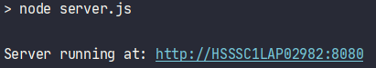
Storing our settings (4)
Create .env file for testing
Run npm start, view console
PORT = 8080

Slide 49
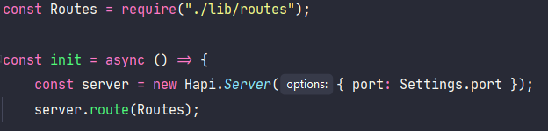
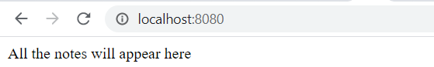
Defining the Routes
Create lib/routes.js
Update server.js
"use strict"; const Path = require("path"); module.exports = [ { method: "GET", path: "/", handler: (request, h) => { return "All the notes will appear here"; }, // The description field in the config section is only for documentation purposes config: { description: "Gets all the notes available" } }, ];

Slide 50
Defining the Routes
Update lib/routes.js
{ method: "POST", path: "/note", handler: (request, h) => { return "New note"; }, config: { description: "Adds a new note" } }, { method: "GET", path: "/note/{slug}", handler: (request, h) => { return "This is a note"; }, config: { description: "Gets the content of a note" } },
{ method: "PUT", path: "/note/{slug}", handler: (request, h) => { return "Edit a note"; }, config: { description: "Updates the selected note" } }, { method: "GET", path: "/note/{slug}/delete", handler: (request, h) => { return "This note no longer exists"; }, config: { description: "Deletes the selected note" } }

Slide 51
Building the Models
Now we will install SQLite and Sequelize to test with database
npm install sequelize sqlite3
Create models folder inside lib/, create lib/models/index.js
"use strict"; const Fs = require('fs'); const Path = require('path'); const { Sequelize } = require('sequelize'); const Settings = require('../../settings'); const dbSetting = Settings[Setting.env]; const sequelize = new Sequelize(dbSetting); const db = {}; // Read Model file and import Fs.readdirSync(__dirname) // Filter is not folder, and is not index.js .filter(file => file.indexOf(".") !== 0 && file !== "index.js") .forEach(file => { const model = sequelize.import(Path.join((__dirname, file))); db[model.name] = model; }); db.sequelize = sequelize; db.Sequelize = Sequelize; module.exports = db;

Slide 52
Building the Models (2)
Update settings.js, .env
We will use moment for date formatting npm install moment
// This will load our .env file and add the values to process.env, require("dotenv").config(); module.exports = { port: process.env.PORT || 3000, env: process.env.NODE_ENV || "development", development: { dialect: "sqlite", storage: ":memory:" }, production: { dialect: "sqlite", storage: "db/database.sqlite" } };
PORT = 8080

Slide 53
Building the Models (3)
Create lib/models/note.js
Update server.js
Require models:
Update to sync database:
"use strict"; const Moment = require('moment'); module.exports = (sequelize, DataTypes) => { const Note = sequelize.define('Note', { date: { type: DataTypes.DATE, get: () => { return Moment().format("MMMM Do, YYYY"); } }, title: DataTypes.STRING, slug: DataTypes.STRING, description: DataTypes.STRING, content: DataTypes.STRING, }); return Note }
const Models = require("./lib/models");
await Models.sequelize.sync(); await server.start(); console.log(`Server running at: ${server.info.uri}`);

Slide 54
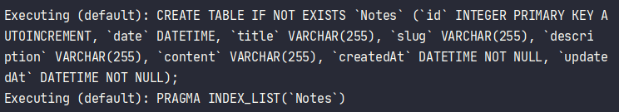
Building the Models (4)
Run start npm start

Slide 55
Building the Controllers
Controllers are functions that accept the request and response toolkit objects from Hapi.js
The request object contains information about the requested resource, and we use reply to return information to the client.
We will build first controller /lib/controllers/home.js
"use strict"; const Models = require("../models/"); module.exports = async (request, h) => { const result = await Models.Note.findAll({ order: [["date", "DESC"]] }); return { data: { notes: result }, page: "Home—Notes Board", description: "Welcome to my Notes Board" }; };

Slide 56
Building the Controllers (2)
Update routes.js
Require controllers/home
Update path “/” to handler with Home
npm start for testing
const Home = require("./controllers/home");
{ method: "GET", path: "/", handler: Home, // The description field in the config section is only for documentation purposes config: { description: "Gets all the notes available" } },

Slide 57
Building the Controllers (3)
Create lib/controllers/note.js
Install slug module: npm i slug
“create” function:
"use strict"; const { Note } = require("../models/"); const Slugify = require("slug"); const Path = require("path"); module.exports = { // Here we’re going to include our functions that will handle the remaining requests in the routes.js file. };
create: async (request, h) => { const result = await Note.create({ date: new Date(), title: request.payload.noteTitle, slug: Slugify(request.payload.noteTitle, {lower: true}), description: request.payload.noteDescription, content: request.payload.noteContent }); return result; }

Slide 58
Building the Controllers (4)
Create “read” function. URL: http://localhost:<PORT>/note/:slug
Create “update” function:
read: async (request, h) => { return Note.findOne({ where: { slug: request.params.slug } }); },
update: async (request, h) => { const values = { title: request.payload.noteTitle, description: request.payload.noteDescription, content: request.payload.noteContent }; const options = { where: { slug: request.params.slug } }; await Note.update(values, options); return Note.findOne(options); },

Slide 59
Building the Controllers (4)
Create “delete” function.
Include note controller into routes.js
Update method handler of note
delete: async (request, h) => { await Note.destroy({ where: { slug: request.params.slug } }); return h.redirect("/"); }
const Note = require("./controllers/note");
{ method: "POST", path: "/note", handler: Note.create, config: { description: "Adds a new note", payload: { multipart: true, } } }

Slide 60
Building the Controllers (5)
{ method: "GET", path: "/note/{slug}", handler: Note.read, config: { description: "Gets the content of a note" } }, { method: "PUT", path: "/note/{slug}", handler: Note.update, config: { description: "Updates the selected note", payload: { multipart: true, } } }, { method: "GET", path: "/note/{slug}/delete", handler: Note.delete, config: { description: "Deletes the selected note" } }

Slide 61
Building the Controllers (6)
In Hap v19, request.payload.multipart was changed to false by default. We need to set it back to true for the POST and PUT routes, as we’ll be using a FormData object to transmit data to the server, and the transmitted data will be in the multipart/form-data format.

Slide 62
Building the Views
In this example, we’re going to use the Pug templating language.
We’re going to use the Vision plugin to enable the view functionality in our server
npm i @hapi/vision@5.5.4 pug
Create lib/views/components/note.pug
article.content h2.title: a(href=`/note/${note.slug}`)= note.title p.subtitle.is-6 Published on #{note.date} p=note.content

Slide 63
Building the Views (2)
Create base layout lib/views/layout.pug
The content of the other pages will be loaded in place of block content
We will create static folder static/public/scripts
doctype html head meta(charset='utf-8') meta(name='viewport' content='width=device-width, initial-scale=1') title=page meta(name='description' content=description) link(rel='stylesheet' href='https://cdn.jsdelivr.net/npm/bulma@0.8.0/css/bulma.min.css') script(defer='' src='https://use.fontawesome.com/releases/v5.3.1/js/all.js') body block content script(src='/scripts/main.js')

Slide 64
Building the Views (3)
Create home view to show list of all the notes and a button that will show a modal window with a form that allow us to create new note via Ajax.
Create lib/views/home.pug
That will extend from layout
Write content display on block content of layout
Include components/note to display with same format:
extends layout
block content ...
main(container).notes-list each note in data.notes include components/note hr

Slide 65
Building the Views (4)
extends layout block content section.section .container h1.title.has-text-centered | Notes Board .tabs.is-centered ul li a.show-modal(href='#') Publish main(container).notes-list each note in data.notes include components/note hr .modal .modal-background .modal-card header.modal-card-head p.modal-card-title Add note button.delete(aria-label='close') section.modal-card-body form(action='/note' method='POST').note-form#note-form .field .control input.input(name='noteTitle' type='text' placeholder='Title') .field .control input.input(name='noteDescription' type='text' placeholder='Short description') .field .control textarea.textarea(name='noteContent' placeholder='Contents') .field .control button.button.is-link Save

Slide 66
Building the Views (5)
The note page is pretty similar to the home page, but in this case, we show a menu with options specific to the current note.
Create lib/views/note.pug

Slide 67
Building the Views (6)
extends layout block content section.section .container h1.title.has-text-centered | Notes Board .tabs.is-centered ul li: a(href='/') Home li: a.show-modal(href='#') Update li: a(href=`/note/${note.slug}/delete`) Delete include components/note .modal .modal-background .modal-card header.modal-card-head p.modal-card-title Edit note button.delete(aria-label='close') section.modal-card-body form(action=`/note/${note.slug}` method='PUT').note-form#note-form .field .control input.input(name='noteTitle' type='text' placeholder='Title' value=note.title) .field .control input.input(name='noteDescription' type='text' placeholder='Short description' value=note.description) .field .control textarea.textarea(name='noteContent' placeholder='Contents') #{note.content} .field .control button.button.is-link Save

Slide 68
Building the Views (7)
To create and update notes, we’ll use some JavaScript, both to show/hide a modal with a form, and to submit the requests via Ajax.
Create static/public/scripts/main.js
// Modal const modal = document.querySelector(".modal"); const html = document.querySelector("html"); const showModal = () => { modal.classList.add("is-active"); html.classList.add("is-clipped"); }; const hideModal = () => { modal.classList.remove("is-active"); html.classList.remove("is-clipped"); }; document.querySelector("a.show-modal").addEventListener("click", function(e) { e.preventDefault(); showModal(); }); modal.querySelector(".modal .delete").addEventListener("click", function(e) { e.preventDefault(); hideModal(); });

Slide 69
Building the Views (8)
Create Form Submit
// Form submit const form = document.querySelector("#note-form"); const url = form.getAttribute("action"); const method = form.getAttribute("method"); const prependNote = html => { const notesList = document.querySelector(".notes-list"); const div = document.createElement("div"); div.innerHTML = html; notesList.insertBefore(div.firstChild, notesList.firstChild); }; const updateNote = html => { const article = document.querySelector("article"); const div = document.createElement("div"); div.innerHTML = html; article.parentNode.replaceChild(div.firstChild, article); };

Slide 70
Building the Views (9)
On Success, we will hide Modal, reset form, and prependNote or call updateNote
const onSuccess = html => { hideModal(); form.reset(); if (method === "POST") { prependNote(html); } else if (method === "PUT") { updateNote(html); } }; form.addEventListener("submit", e => { e.preventDefault(); fetch(url, { method, body: new FormData(form) }) .then(response => response.text()) .then(text => onSuccess(text)) .catch(error => console.error(error)); });

Slide 71
Building the Views (10)
Adding Support for Views on the Server
In our server.js, import Path, and we will use it to include our view
We replace server.route(Routes) with below codes
const Path = require("path");
await server.register([require("@hapi/vision")]); server.views({ engines: { pug: require("pug") }, path: Path.join(__dirname, "lib/views"), compileOptions: { pretty: false }, isCached: Settings.env === "production" }); // Add routes server.route(Routes);

Slide 72
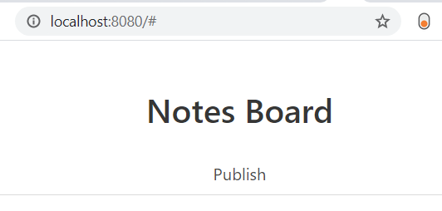
Building the Views (11)
Setting the Home view
Open lib/controllers/home.js, replace return statement:
Now, you can start and test it.
You should see it, but you can’t click Publish button
return h.view('home', { data: { notes: result }, page: 'Home—Notes Board', description: 'Welcome to my Notes Board' });

Slide 73
Building the Views (12)
Setting the Note view, create function
Open lib/controllers/note.js, require pug on the top of note.js
In the create method, replace the return result:
We use the renderFile method from Pug to render the note template with the data we just received from our model.
const Pug = require("pug");
return Pug.renderFile( Path.join(__dirname, "../views/components/note.pug"), { note: result } );

Slide 74
Building the Views (13)
Setting the Note view, read function
In the read method, replace the return result:
const note = await Note.findOne({ where: { slug: request.params.slug } }); return h.view("note", { note, page: `${note.title}—Notes Board`, description: note.description });

Slide 75
Building the Views (14)
Setting the Note view, update function
In the update method, replace the return result:
const result = Note.findOne(options); return Pug.renderFile( Path.join(__dirname, "../views/components/note.pug"), { note: result } );

Slide 76
Serving Static Files
The JavaScript and CSS files that we’re using on the client side are provided by Hapi.js from the static/public/ directory.
But it won’t happen automatically; we must indicate to the server that we want to define this folder as public.
We can use Inert package npm install @hapi/inert
In the server.register function inside the server.js, we will import Inert plugin, and register it with Hapi:
await server.register([require("@hapi/vision"), require("@hapi/inert")]);

Slide 77
Serving Static Files (2)
Now we have to define the route where we’re going to provide the static files, and their location on our server’s filesystem
Add the following entry at the end of routers.js:
This route will use the GET method, and we’ve replaced the handler function with an object containing the directory that we want to make public.
{ // Static files method: "GET", path: "/{param*}", handler: { directory: { path: Path.join(__dirname, "../static/public") } }, config: { description: "Provides static resources" } }

Slide 78
Local Authentication Using Passport in Node.js
Focus Items
Authentication Strategies: Session vs JWT
Create Project
Setting up Passport
Creating a MongoDB Data Store
Connecting Mongo to Node with Mongoose
Implementing Local Authentication
The Client

Slide 79
Authentication Strategies: Session vs JWT
Many of the tutorials online today will opt for token-based authentication using JSON Web Tokens (JWTs).
This approach is probably the simplest and most popular one nowadays.
It relegates part of the authentication responsibility to the client and makes them sign a token that’s sent with every request, to keep the user authenticated.
Session-based authentication has been around longer
This method relegates the weight of the authentication to the server
It uses cookies and sees the Node application and database work together to keep track of a user’s authentication state
We will create example for session-based

Slide 80
Creating the Project
Create AuthApp folder, call npm init to create package.json
Update package.json
We will use express to build example.
Run command: npm i express body-parser express-session
Create index.js
"scripts": { "test": "echo \"Error: no test specified\" && exit 1", "start": "node index.js" },
/* EXPRESS SETUP */ const express = require('express'); const app = express(); app.use(express.static(__dirname)); const bodyParser = require('body-parser'); const expressSession = require('express-session')({ secret: 'secret', resave: false, saveUninitialized: false }); app.use(bodyParser.json()); app.use(bodyParser.urlencoded({ extended: true })); app.use(expressSession); const port = process.env.PORT || 3000; app.listen(port, () => console.log('App listening on port ' + port));

Slide 81
Setting up Passport
Run command: npm i passport
Update index.js before listen
Here, we require passport and initialize it along with its session authentication middleware, directly inside our Express app
/* PASSPORT SETUP */ const passport = require('passport'); app.use(passport.initialize()); app.use(passport.session());

Slide 82
Connecting Mongo to Node with Mongoose
Why do we use mongoose?
writing MongoDB validation, casting and business logic boilerplate is a drag
Mongoose will simply make our lives easier and our code more elegant
Run command to install mongoose npm i mongoose passport-local-mongoose
We’ll also be using passport-local-mongoose, which will simplify the integration between Mongoose and Passport for local authentication
It will add a hash and salt field to our Schema in order to store the hashed password and the salt value

Slide 83
Connecting Mongo to Node with Mongoose
Now we update index.js to configure Mongoose
We use mongoose.connect to connect to database
Create UserDetail schema to store data, and add passportLocalMongoose as a plugin to schema
/* MONGOOSE SETUP */ const mongoose = require('mongoose'); const passportLocalMongoose = require('passport-local-mongoose'); mongoose.connect('mongodb://localhost/MyDatabase', { useNewUrlParser: true, useUnifiedTopology: true }); const Schema = mongoose.Schema; const UserDetail = new Schema({ username: String, password: String }); UserDetail.plugin(passportLocalMongoose); const UserDetails = mongoose.model('userInfo', UserDetail, 'userInfo');

Slide 84
Implementing Local Authentication
We update index.js, use passport to implement local authentication.
First, we make passport use the local strategy by calling createStrategy() on our UserDetails model (passport-local-mongoose will take care of everything so that we don’t have to set up the strategy.)
After that, we use serializeUser and deserializeUser callbacks
serializeUser: serialize the user instance with the information we pass on to it and store it in the session via the cookie
deserializeUser: will be invoked every subsequent request to deserialize the instance, providing it the unique cookie identifier as “credential”
/* PASSPORT LOCAL AUTHENTICATION */ passport.use(UserDetails.createStrategy()); passport.serializeUser(UserDetails.serializeUser()); passport.deserializeUser(UserDetails.deserializeUser());

Slide 85
Routes
Now, let’s add some routes to tie everything together.
We will use connect-ensure-login package that ensure a user is logged in. npm i connect-ensure-login
Add some routes to index.js
const connectEnsureLogin = require('connect-ensure-login'); app.post('/login', (req, res, next) => { passport.authenticate('local', (err, user, info) => { if (err) { return next(err); } if (!user) { return res.redirect('/login?info=' + info); } req.logIn(user, function(err) { if (err) { return next(err); } return res.redirect('/'); }); })(req, res, next); });

Slide 86
Routes (2)
app.get('/login', (req, res) => res.sendFile('html/login.html', { root: __dirname }) ); app.get('/', connectEnsureLogin.ensureLoggedIn(), (req, res) => res.sendFile('html/index.html', {root: __dirname}) ); app.get('/private', connectEnsureLogin.ensureLoggedIn(), (req, res) => res.sendFile('html/private.html', {root: __dirname}) ); app.get('/user', connectEnsureLogin.ensureLoggedIn(), (req, res) => res.send({user: req.user}) );

Slide 87
The Client
Create html/index.html
<!DOCTYPE html> <html lang="en"> <head> <meta charset="UTF-8"> <title>Home</title> <link rel="stylesheet" href="css/styles.css"> </head> <body> <div class="message-box"> <h1 id="welcome-message"></h1> <a href="/private">Go to private area</a> </div> <script> const req = new XMLHttpRequest(); req.onreadystatechange = function () { if (req.readyState == 4 && req.status == 200) { const user = JSON.parse(req.response).user; document.getElementById("welcome-message").innerText = `Welcome ${user.username}!!`; } }; req.open("GET", "http://localhost:3000/user", true); req.send(); </script> </body> </html>

Slide 88
The Client (2)
<!DOCTYPE html> <html lang="en"> <head> <meta charset="UTF-8"> <title>Login</title> </head> <body> <form action="/login" method="post"> <div class="title"> <h3>Login</h3> </div> <div class="field"> <label>Username:</label> <input type="text" name="username" /> <br /> </div> <div class="field"> <label>Password:</label> <input type="password" name="password" required /> </div> <div class="field"> <input class="submit-btn" type="submit" value="Submit" required /> </div> <label id="error-message"></label> </form> <script> const urlParams = new URLSearchParams(window.location.search); const info = urlParams.get('info'); if(info) { const errorMessage = document.getElementById("error-message"); errorMessage.innerText = info; errorMessage.style.display = "block"; } </script> </body> </html>
Create html/login.html

Slide 89
The Client (3)
Create html/private.html
<!DOCTYPE html> <html lang="en"> <head> <meta charset="UTF-8"> <title>Private</title> <link rel="stylesheet" href="css/styles.css"> </head> <body> <div class="message-box"> <h2>This is a private area</h2> <h3>Only you can see it</h3> <a href="/">Go back</a> </div> </body> </html>

Slide 90
The Client (4)
body { display: flex; align-items: center; background: #37474F; font-family: monospace; color: #cfd8dc; justify-content: center; font-size: 20px; } .message-box { text-align: center; } a { color: azure; } .field { margin: 10px; } input { font-family: monospace; font-size: 20px; border: none; background: #1c232636; color: #CFD8DC; padding: 7px; border: #4c5a61 solid 2px; width: 300px; } .submit-btn { width: 100% } .title { margin: 10px 0px 20px 10px } #error-message { color: #E91E63; display: block; margin: 10px; font-size: large; max-width: fit-content; }
Create css/styles.css

Slide 91
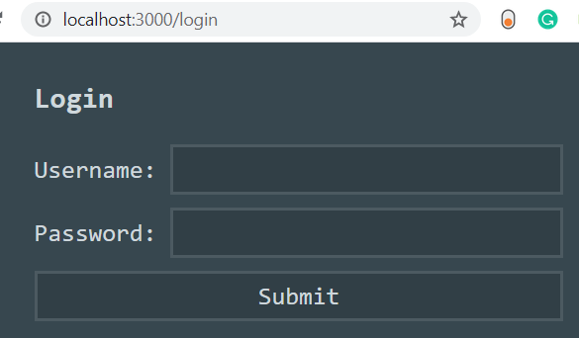
The Client (5)
Start for testing npm start
Link http://localhost:3000/private, it will redirect to http://localhost:3000/login

Slide 92
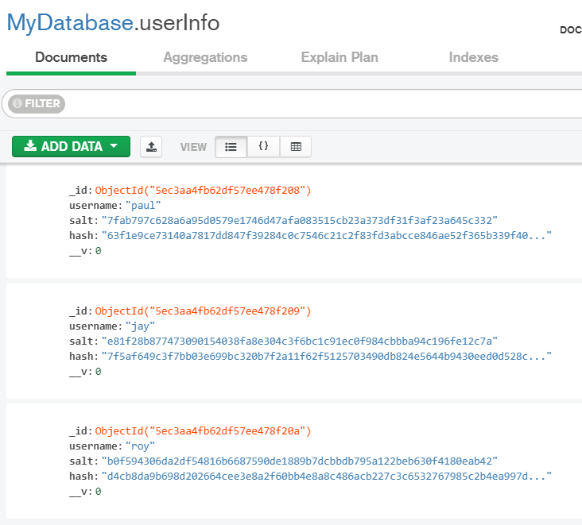
The Client (6)
We will register some user for testing
Update index.js
Start app, check mongoDB Compass
/* REGISTER SOME USERS */ UserDetails.register({username:'paul', active: false}, 'paul'); UserDetails.register({username:'jay', active: false}, 'jay'); UserDetails.register({username:'roy', active: false}, 'roy');

Slide 93
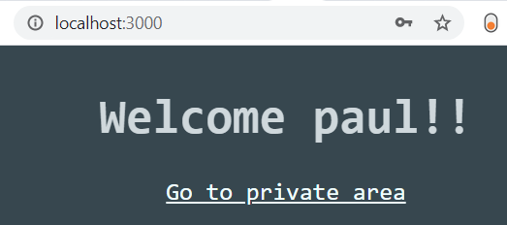
The Client (6)
Use username and password to login

Slide 94
Q&A

